Slide 1
Anesthesia And Perioperative Care
Dr Rajesh Raman

Slide 2
Anesthesia
Preoperative assessment and optimization
Intraoperative care
Postoperative care

Slide 3
Preoperative Assessment & Optimization

Slide 4
Pre-operative checkup
Advantages:
↓ cancellations on day of surgery
↓ tests
↓ hospital stay and costs
↓anxiety
Better counselling
Goals:
Optimization of surgical & co-morbid conditions
Detection of diseases
Perioperative risk estimation
Consent & counselling

Slide 5
Perioperative Risk Assessment

Slide 6
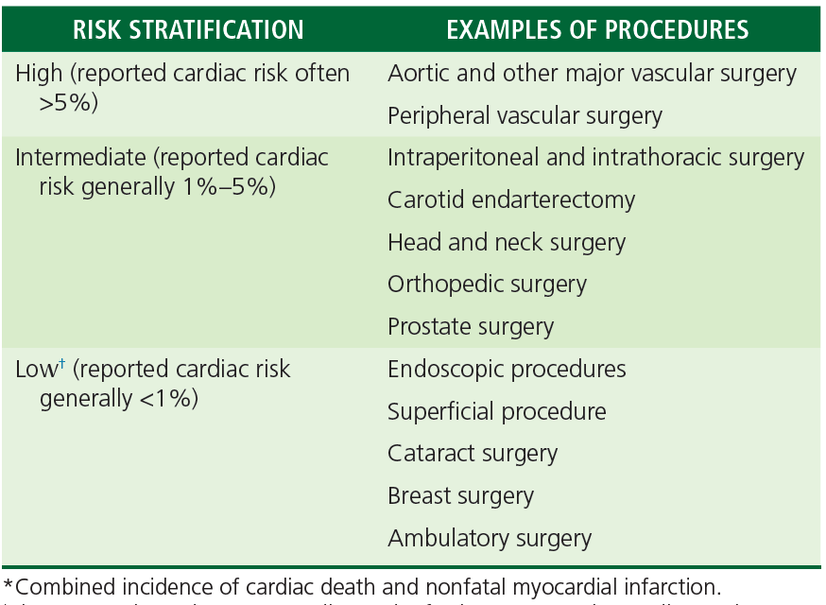
Risk due to surgery

Slide 7
Risk Scores: Revised Cardiac Risk Index
Components | Points Assigned
High-risk surgery (intraperitoneal, intrathoracic, or suprainguinal vascular procedure) | 1
Ischemic heart disease | 1
History of congestive heart failure | 1
History of cerebrovascular disease | 1
Diabetes mellitus requiring insulin | 1
Creatinine > 2.0 mg/dL | 1
RCRI Score | Risk of major cardiac events*
0 | 0.4%
1 | 0.9%
2 | 2.4%
≥ 3 | 5.4%
*MI, cardiac death, pulmonary edema, VF, CHB
ASA Physical Status

Slide 8
Routine investigations
For ASA I & II patients
Risk of Surgery | CBC | Renal fn. test | LFT | ECG | Chest X-ray | Electrolytes, GB, Coag.
Low | √ | X | X | >45 Y | X | X
Intermediate | √ | √ | X | >45 Y | >50 Y | X
High | √ | √ | √ | >45 Y | >50 Y | X
For ASA ≥III: investigate according to the comorbid disease
Blood Ix valid for 2 months, CXR & ECG valid for 1 year- if no change in clinical condition

Slide 9
Medication Management
Cardiovascular drugs: All drugs are continued till morning of surgery.
Exceptions: ACE inhibitors/ARB if big fluid shifts are anticipated
Don’t start Beta blockers within 1-2 days before surgery.
Respiratory, psychiatry, anti-epileptic: continue
Oral antidiabetic: stop metformin 1 day before major Sx.
Other: give till night, omit morning dose.
Insulins: give 2/3 of night dose, omit morning dose
Steroids: >10mg/day prednisolone equivalent within 3 months: give stress dose of hydrocortisone 50-100 mg before surgery

Slide 10
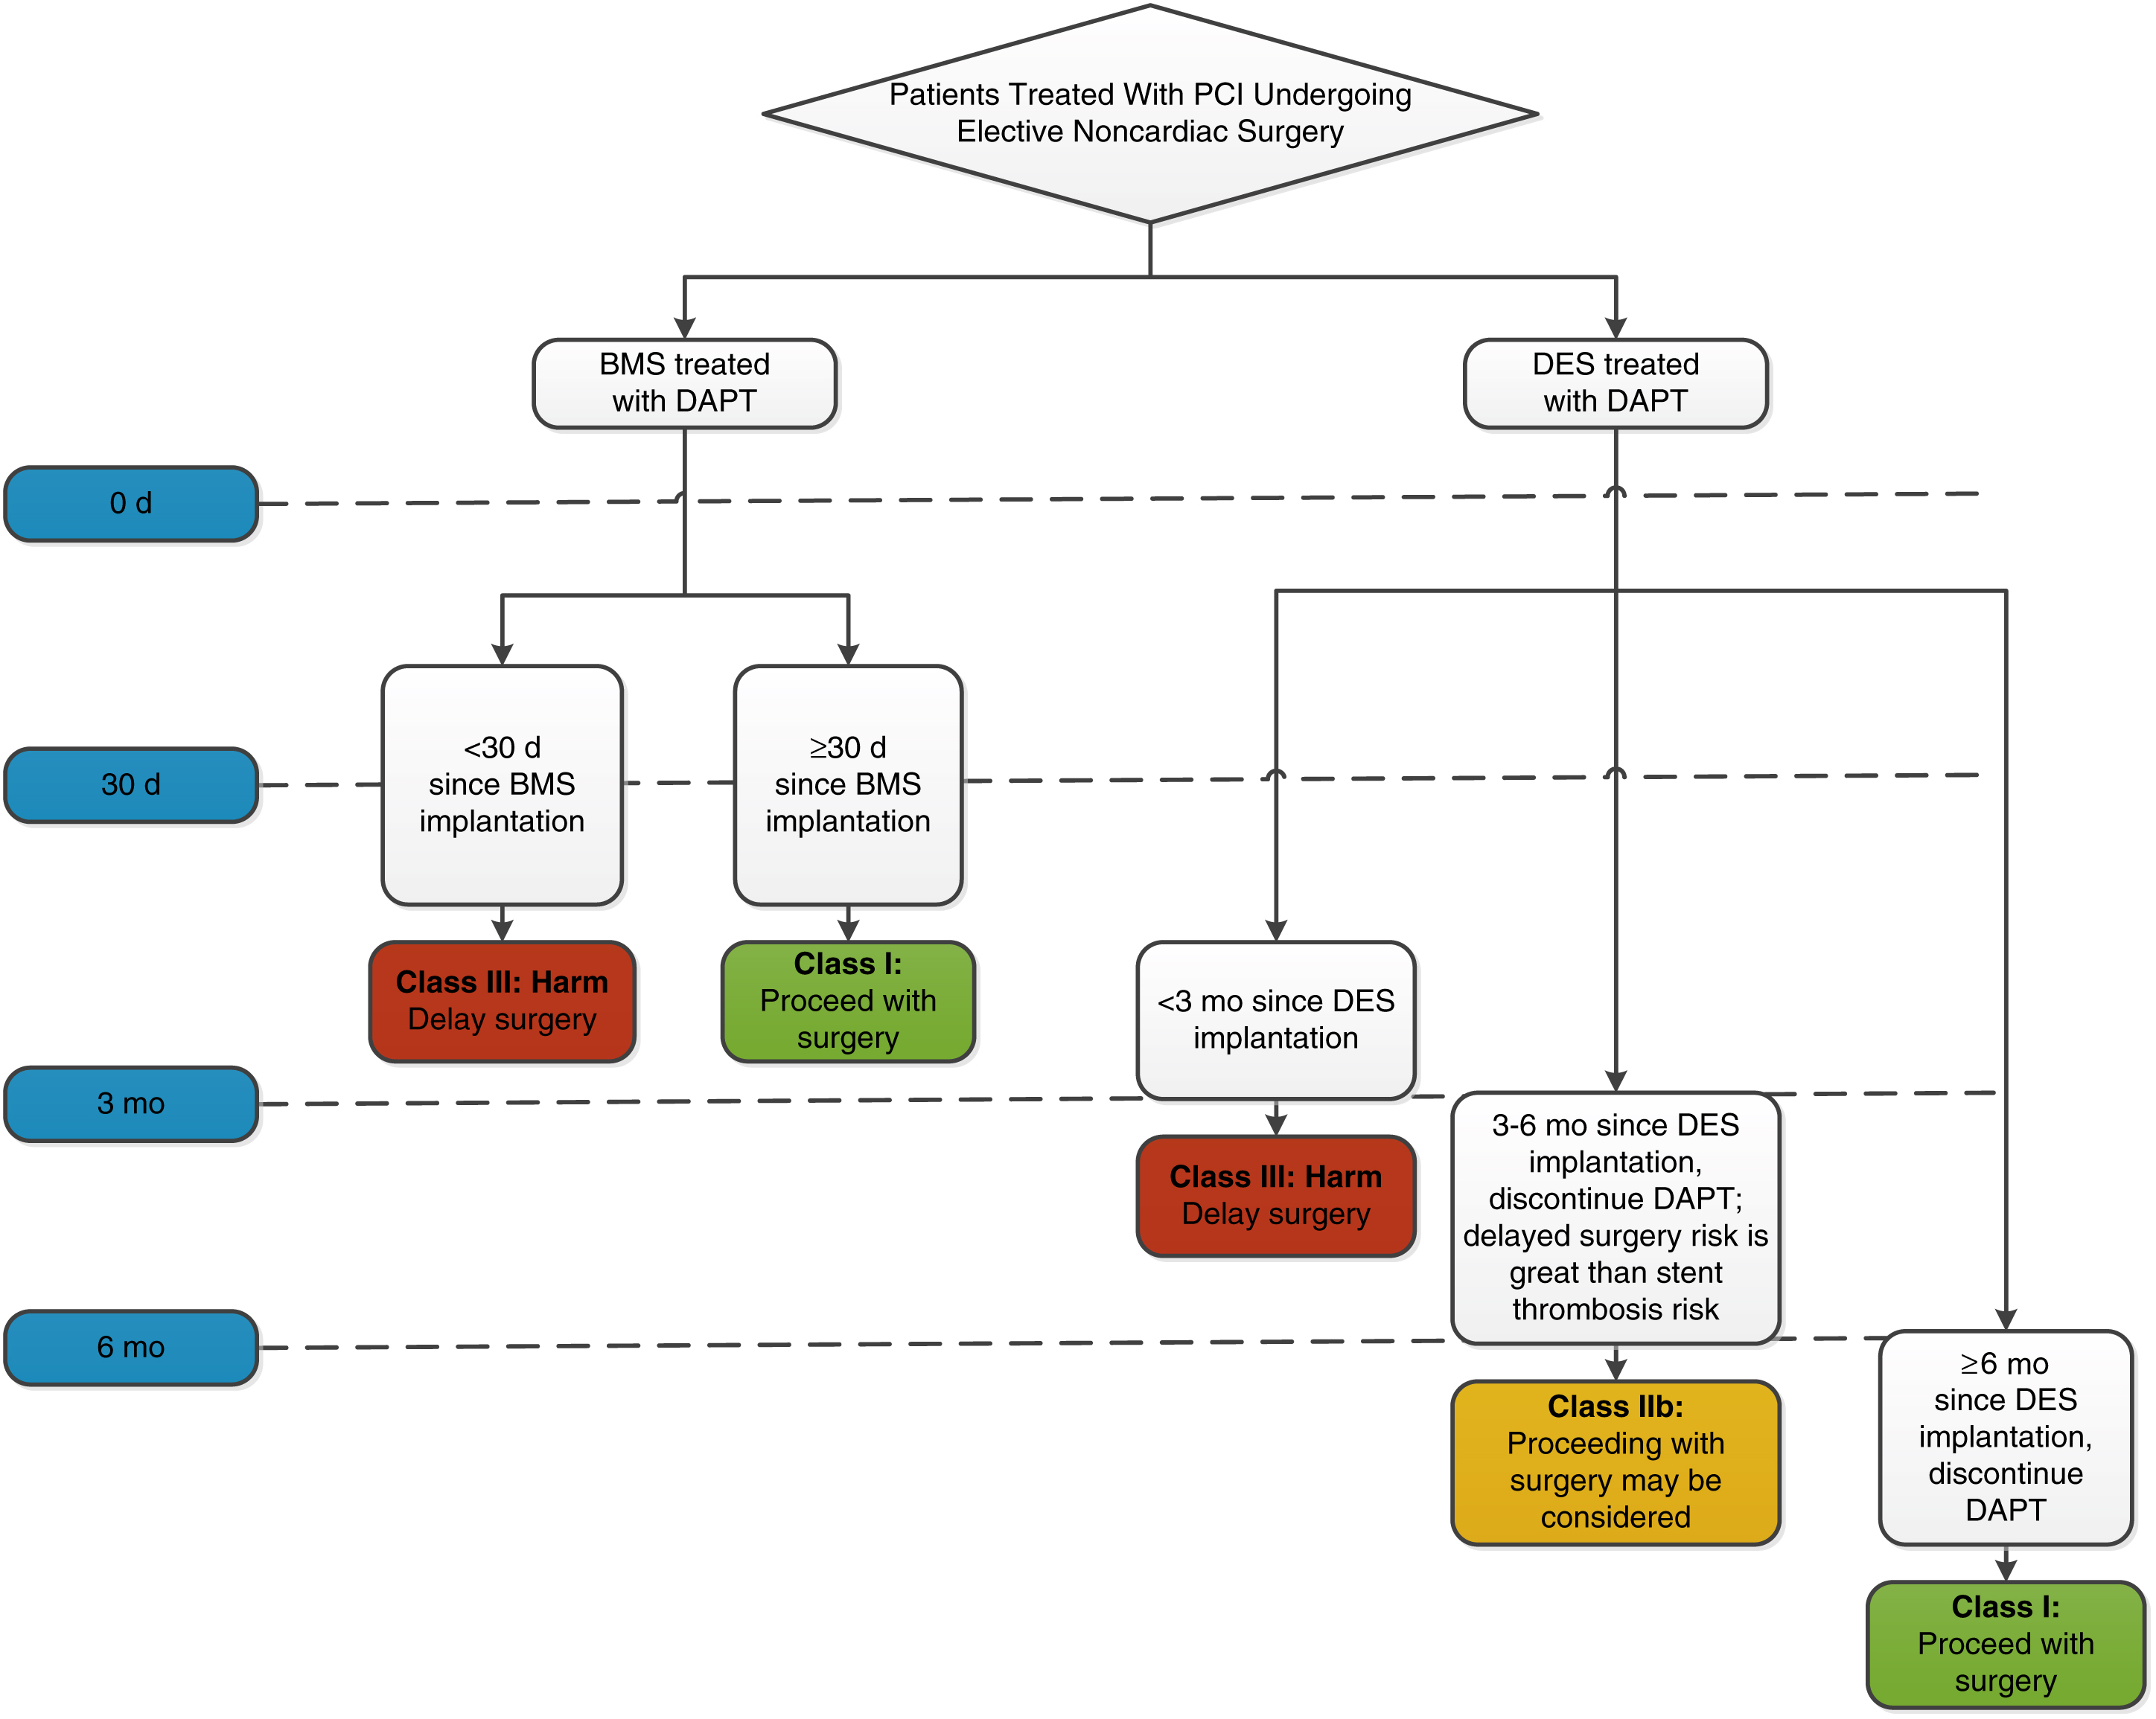
Antiplatelets

Slide 11
Preoperative advice
NPO: 2 hours for clear fluids, at least 6 hours for solid food
Drugs: most are to be continued
Premedication:
Aspiration prophylaxis: only for patients at high risk of aspiration
Ranitidine, metoclopramide
Sedative medication
Midazolam: 1 hour before surgery- in anxious patients
Anti-sialagogues: not routinely used
Consent and counselling
HAVE A PLAN FOR INTRAOPERATIVE AND POSTOPERATIVE MANAGEMENT

Slide 12
Intraoperative Management

Slide 13
General Anesthesia
Induction
Propofol: most commonly used
Ketamine: patients with shock/hypotension
Thiopentone: rarely used
Additional: fentanyl, muscle relaxant
Maintenance
Recovery/emergence
Airway: ETT/SGA
Inhalational agents: sevoflurane/isoflurane, N2O
MR: vecuronium, atracurium, rocuronium
± Midazolam
Stop inhalational agents
Muscle relaxant reversal: Neostigmine + glycopyrrolate
Analgesic: additional fentanyl, PCM
Optional: dexmedetomidine, propofol infusion

Slide 14
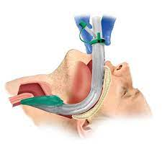
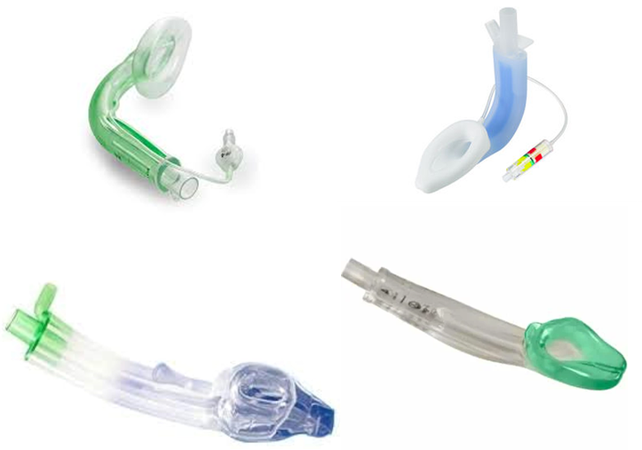
Supraglottic airway devices

Slide 15
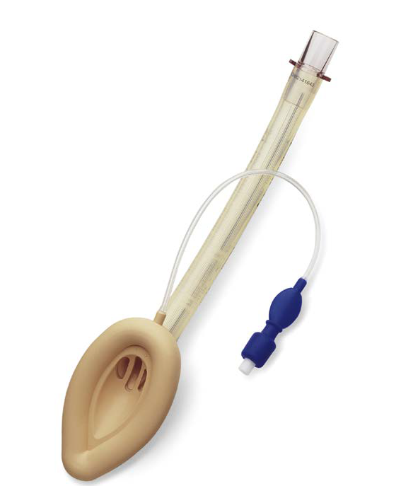

Slide 16
Supraglottic airway devices
Advantages
Uses
Easy to insert
Less invasive than ETT
Less depth of anesthesia needed
Muscle relaxant- lower/omit
Less trauma to lower airway
Hemodynamic stability
Possible to use even if intubation fails
For regular GA: generally, 2-4 H
Rescue after intubation fails
Conduit for intubation
URTI/Asthma/COPD

Slide 17
Minimum Mandatory Monitoring
Circulation:
ECG
Blood pressure
Pulse rate: pulse oximeter
Respiration & oxygenation:
EtCO2 graph- not needed for RA
SPO2
Chest movement/tidal volume
Optional:
Temperature: if changes in temperature are expected
Urine output

Slide 18
Emergence/Reversal
Sedative agents (midazolam, inhalational agents, dexmedetomidine) are stopped at the end of surgery.
Their effect ends due to metabolism or redistribution from brain to other tissues.
Muscle relaxants- vecuronium, atracurium and rocuronium need reversal using anti-acetylcholinestrases: neostigmine
Inhibit acetylcholinestrases- increase the concentration of acetylcholine at neuromuscular junction
Neostigmine has chlionergic side-effects: ↑secretions, bronchospasm, bradycardia- requires glycopyrrolate to prevent these.

Slide 19
Delayed recovery after anesthesia
Metabolic factors
↓↑ Temp.
↓↑Na
↓↑Thyroid
Resp. acidosis
Drugs
↑dose
↓excretion: liver/renal
Age
Obesity
Complications:
Stroke/
CNS ischemia
Seizures
MI
Pul. Embolism
↓↑ Glucose
Pregnancy
Fluid overload
Long duration

Slide 20
Postoperative care

Slide 21
Transfer
Patient accompanied by an anesthesia care team member
Detailed handoff is important to transfer vital preoperative and intraoperative details
surgical condition and procedure,
comorbid conditions and their management,
anesthesia technique used,
drugs, fluid intake and output,
intraoperative complications, and
postoperative instructions

Slide 22
Assessment in PACU
Immediately on arrival
Airway (patency),
breathing (respiratory rate and saturation),
circulation (heart rate, blood pressure, ECG),
mental status, temperature, nausea, and pain
At least every 15 minutes
All the above +
Urine output
Bleeding
fluid intake and hydration status
Immediately identify common problems in ICU

Slide 23
Common Problems in PACU

Slide 24
Hypoxia
Upper airway obstruction: Residual effects of sedatives, opioids, muscle relaxants- results in loss of pharyngeal tone, tongue fall.
Paradoxical breathing: retraction and collapse of chest wall and excessive abdominal wall movement on inspiration
More common in obese, OSA patients
Management:
Jaw thrust, neck extension, oxygen supplemental
Oral/nasal airway
CPAP, intubation

Slide 25
Hypoxia
Residual neuromuscular block:
Contributing factors: hypothermia, electrolyte disorders, hepatic or renal disorders, and drugs like amikacin, lignocaine, calcium channel blockers, and steroids.
Diagnosed using neuromuscular monitoring
Mx additional doses of anticholinesterases + other Mx of airway obstruction

Slide 26
Hypotension
Causes: hypovolemia, bleeding, cardiac dysfunction, vasodilation, tension pneumothorax.
Check intraoperative fluid balance, diuretic use, and bleeding
Neuraxial techniques (epidural, spinal)can cause hypotension
Mx: IV fluids ± blood ± vasopressors,

Slide 27
Myocardial Ischemia
NSTEMI is more common than STEMI
Mostly preceded by periods of tachycardia
Mostly asymptomatic: analgesics, sedatives
May manifest as hemodynamic instability and ECG changes
ECG: ST-T changes, left bundle branch block, ectopic beats, arrhythmias
Pulmonary edema, crepitations, systolic muermur of MR
Mx: supplemental oxygen, non-enteric coated aspirin (165-325 mg), NTG and morphine
For STEMI, PCI is preferred to fibrinolysis

Slide 28
Acute kidney injury
Defined as:
↑ serum creatinine by ≥0.3 mg/dl in 48 hours, or >1.5 time baseline OR
Urine output <0.5 ml/kg/hr for > 6 hours
Pre-renal cause: due to hypovolemia is the most common cause in PACU
Post-renal cause due to ureter injury can occur in lower abdominal surgery
Patients with pre-existing kidney disease are more prone to AKI

Slide 29
………….Acute kidney injury
If hypovolemia is suspected to be cause of AKI- administer fluid bolus
Diuretics should not be given without excluding hypovolemia
Diuretics will worsen hypovolemia and AKI
An ultrasound KUB helps in detecting obstructive and intrinsic renal etiologies of AKI

Slide 30
Discharge from PACU
Variable Evaluated | Score
Vital Signs
Systemic blood pressure and heart rate within 20% of the preanesthetic level | 2
Systemic blood pressure and heart rate 20% to 40% of the preanesthetic level | 1
Systemic blood pressure and heart rate >40% of the preanesthetic level | 0
Activity Level (Able to Ambulate at Preoperative Level)
Steady gait without dizziness or meets the preanesthetic level | 2
Requires assistance | 1
Unable to ambulate | 0
Nausea and Vomiting
None to minimal | 2
Moderate | 1
Severe (continues after repeated treatment) | 0
Pain
Acceptability:
Yes | 2
No | 1
Surgical Bleeding
Minimal (does not require dressing change) | 2
Moderate (up to two dressing changes required) | 1
Severe (more than three dressing changes required) | 0

Slide 31
THANK YOU

